Slide 1
2nd Place Solution
Instacart Market Basket Analysis

Slide 2
Agenda
My Background
Problem Overview
Main Approach
Feature Engineering
Feature Importance
Important Findings
F1 maximization

Slide 3
My Background
Bachelor of Economics
Programmer of Financial Industry
Consultant of Financial Industry
2nd Place at KDDCUP2015
Data Scientist at Yahoo! JAPAN

Slide 4
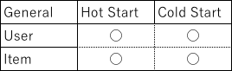
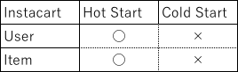
Problem Overview
In this competition, we have to predict reorder.
So, it is little different from general recommendation.
I mean,

Slide 5
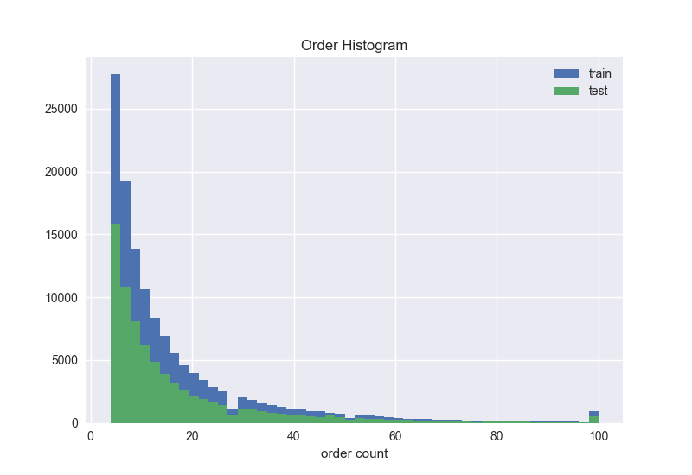
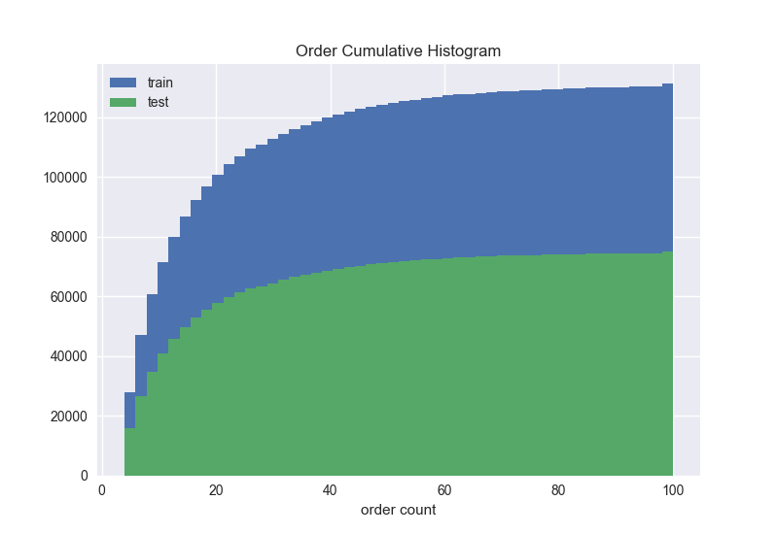
Problem Overview
How hot(user)?
*prior is regarded as train

Slide 6
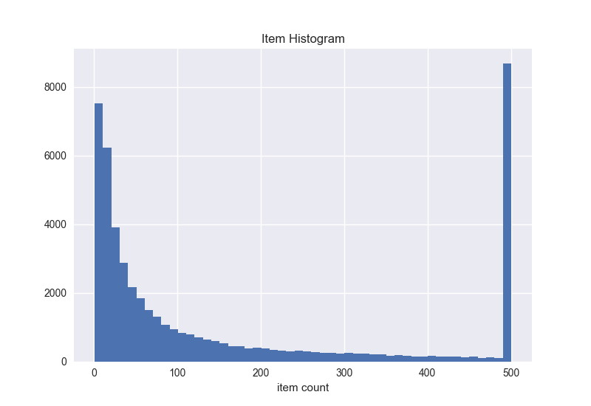
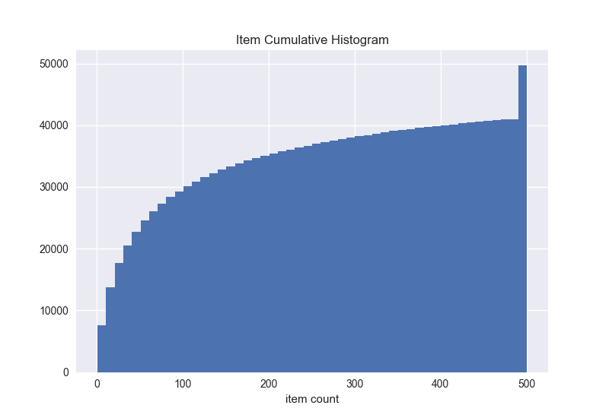
Problem Overview
How hot(item)?
*Clipped by 500

Slide 7
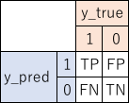
Problem Overview
Evaluation metric is mean F1 score
Precision and Recall

Slide 8
Problem Overview
Links between the files

Slide 9
Main Approach
I made 2 models. For predicting reorder and for predicting None*
reorder model’s keys are user_id and product_id
None model’s key is only user_id
I thought I should use more train data to make better prediction
I decided to use prior as train
As a result of tunings, best number of window is 3
See next page for details
*None means there is no reorder

Slide 10
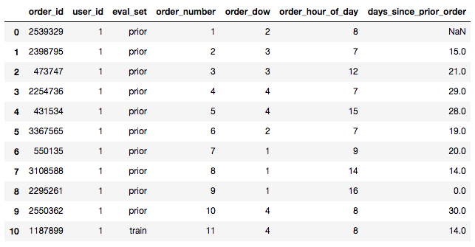
Main Approach
We are given orders.csv

Slide 11
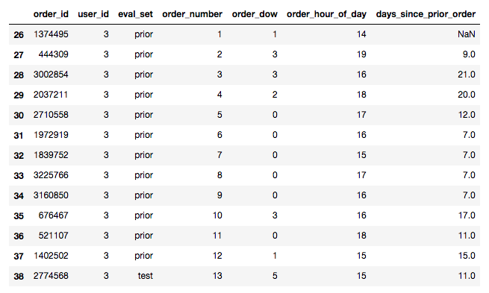
Main Approach
We are given orders.csv

Slide 12
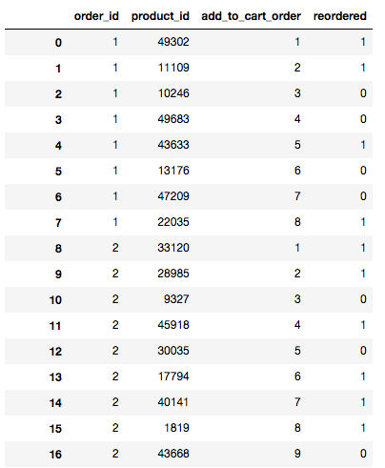
Main Approach
We are given order_products.csv

Slide 13
Main Approach
user_id product_id label
Reorder Prediction

Slide 14
Main Approach
user_id label
None Prediction

Slide 15
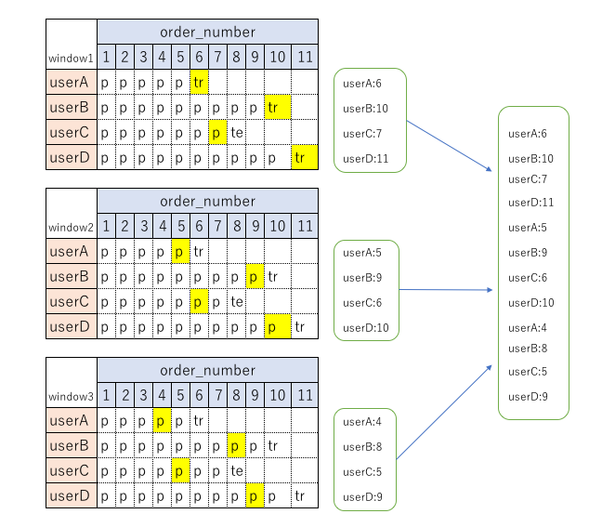
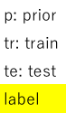
Main Approach

Slide 16
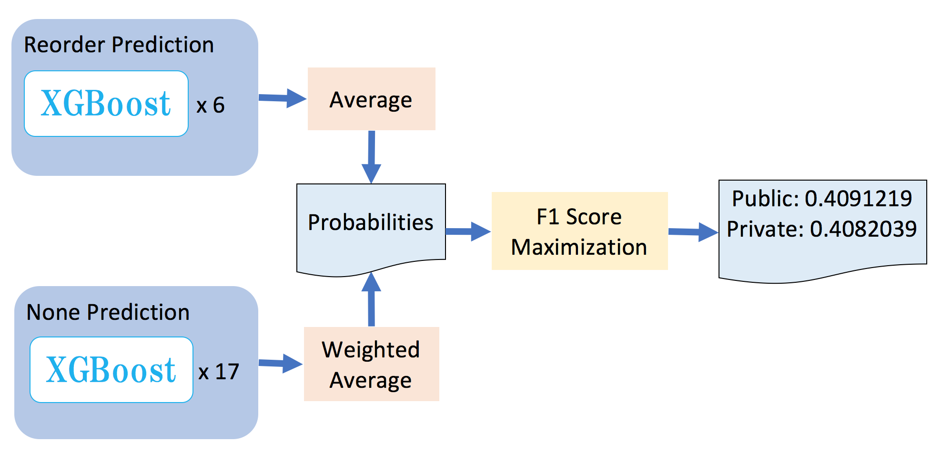
Main Approach

Slide 17
Feature Engineering
I made 4 types of features
User
What this user like
Item
What this item like
User x Item
How do the user feel about the item
Datetime
What this day and hour like
*For None model, I can’t use above features except user and datetime. So I convert those to stats(min, mean, max, sum, std…).

Slide 18
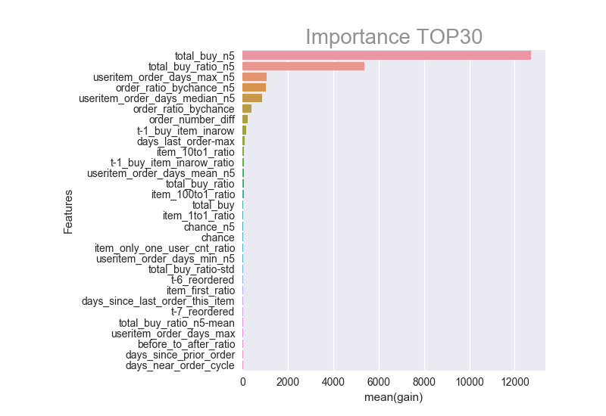
Feature Importance for reorder

Slide 19
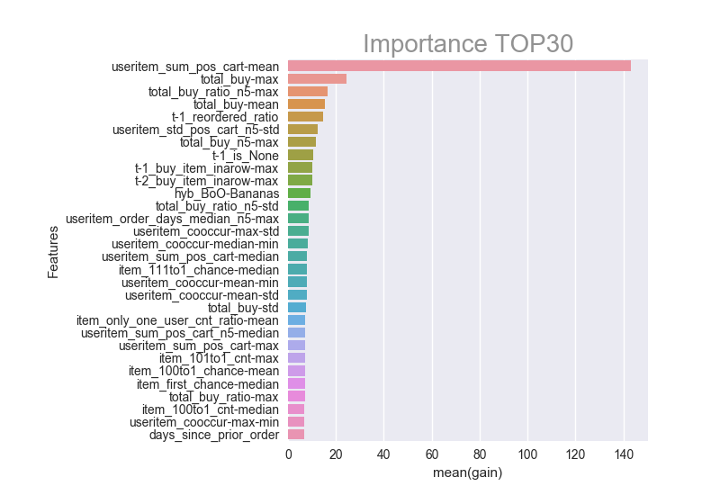
Feature Importance for None

Slide 20
Important Findings for reorder - 1
Let’s think about the reordering problem. Common sense tells us that an item purchased many times in the past has a high probability of being reordered. However, there may be a pattern for when the item is not reordered. We can try to figure out this pattern and understand when a user doesn’t repurchase an item.
See next page for details

Slide 21
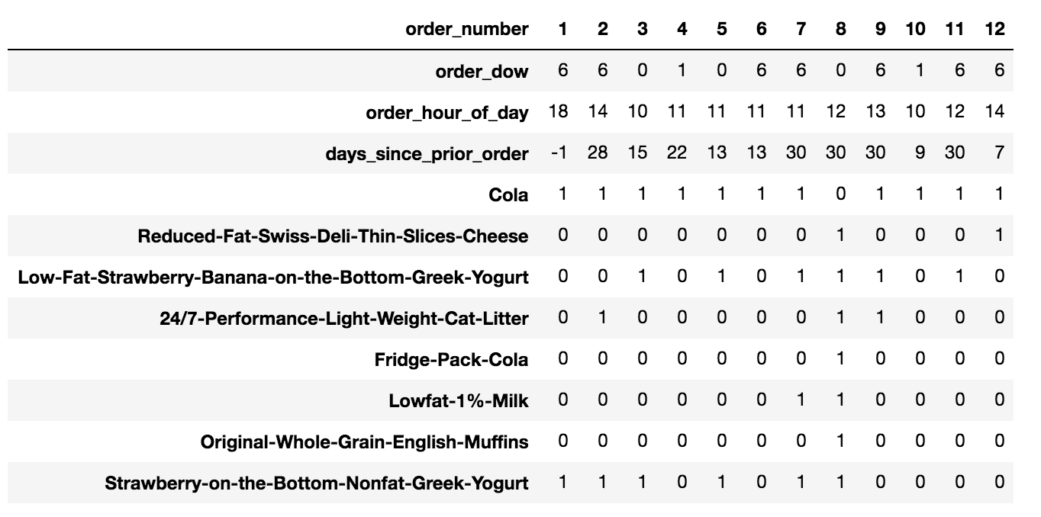
Important Findings for reorder - 1
user_id: 54035

Slide 22
Important Findings for reorder - 1
This user always reorders Cola.
But at order number 8, the user didn’t. Why not?
Probably because the user bought Fridge Pack Cola instead.
I created features to catch this type of behavior.

Slide 23
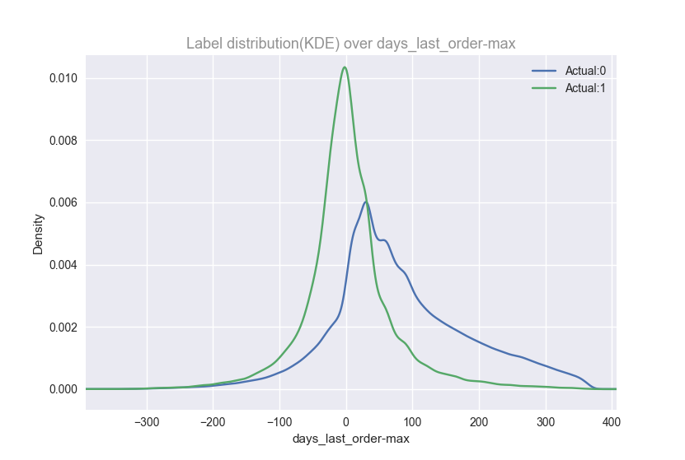
Important Findings for reorder - 2
days_last_order-max is difference between days_since_last_order_this_item and useritem_order_days_max
days_since_last_order_this_item is a feature belong to user and item. This means how many days passed since last order
Also, useritem_order_days_max is a feature belong to user and item. This means max span(day) of order
For more detail, see the next page

Slide 24
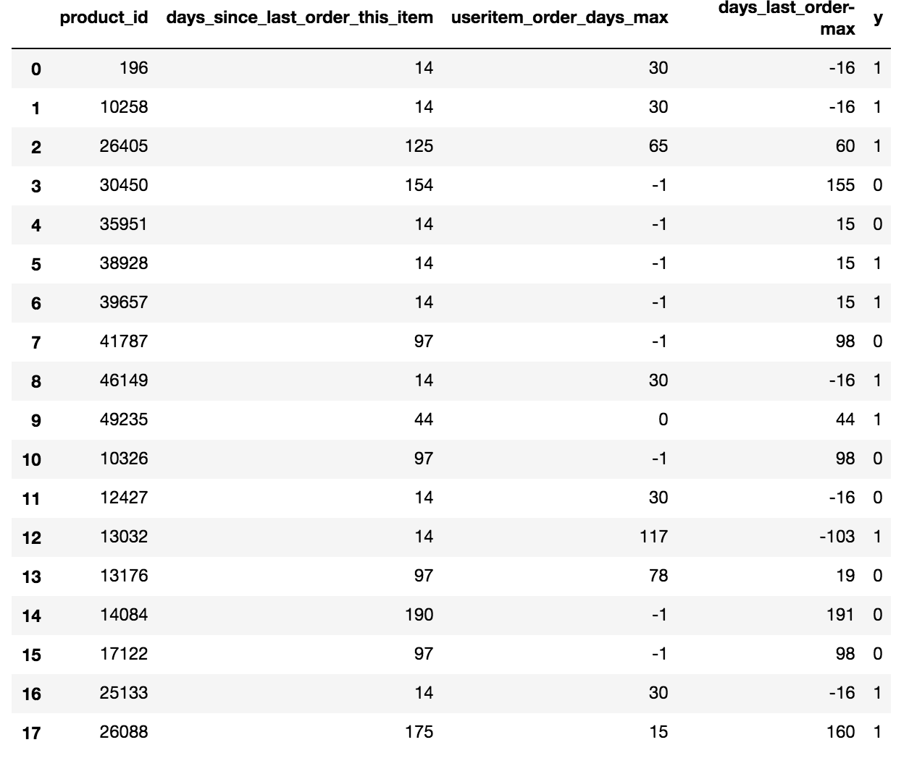
Important Findings for reorder - 2
See the index 0, this means
the user bought this item 14 days
ago, and max span is 30 days
So I think this feature says if the user
is bored or not by that item

Slide 25
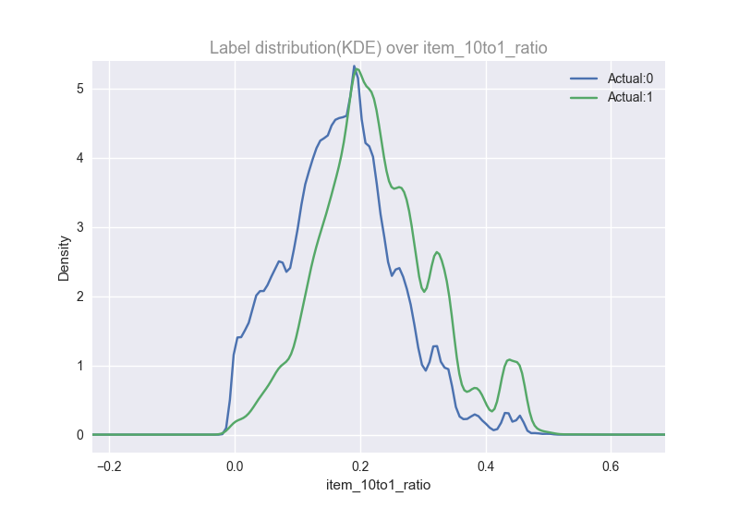
Important Findings for reorder - 3
We already know fruits are reordered more frequently than vegetables(3 Million Instacart Orders, Open Sourced)
I wanted to know how often
So I made a item_10to1_ratio feature
that’s defined as the reorder ratio after
an item is ordered vs. not ordered.
Next page, for more details

Slide 26
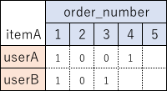
Important Findings for reorder - 3
Let’s say userA bought itemA at order_number 1 and 4
And userB bought itemA at order_number 1 and 3
item_10to1_ratio is 0.5

Slide 27
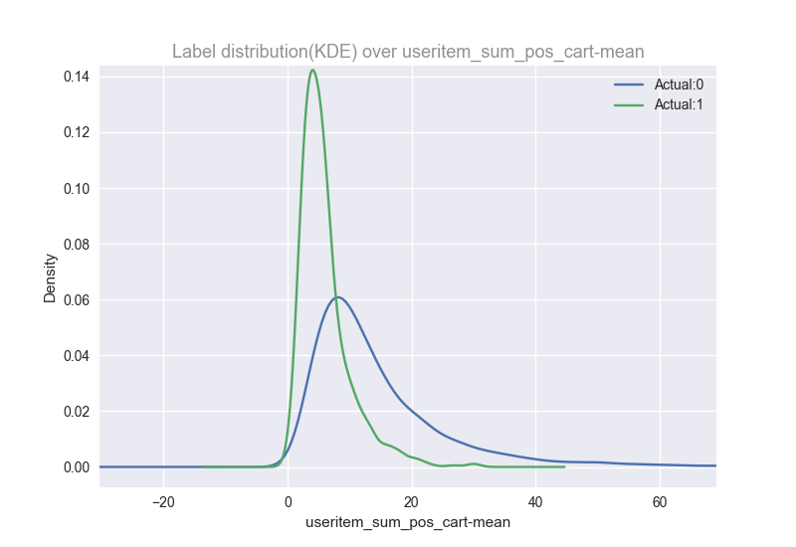
Important Findings for None - 1
Useritem_sum_pos_cart(User A, Item B) is the average position in User A’s cart that Item B falls into
Useritem_sum_pos_cart-mean(User A) is the mean of the above feature across all items
So this feature essentially captures
the average position of an item in a user’s
cart, and we can see that users who
don’t buy many items all at once are
more likely to be None

Slide 28
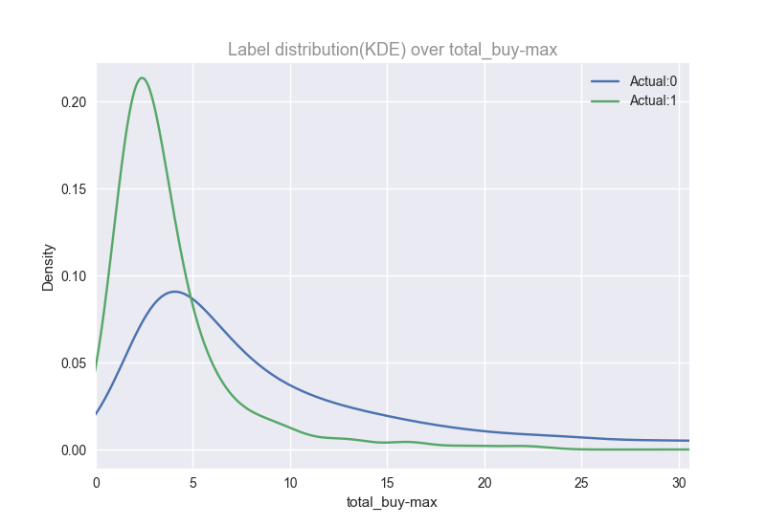
Important Findings for None - 2
total_buy is number of total order
If userA bought itemA 3 times
in the past, this would be 3
So total_buy-max is max of above
feature by user
We can see that it predicts
whether or not a user will make a reorder

Slide 29
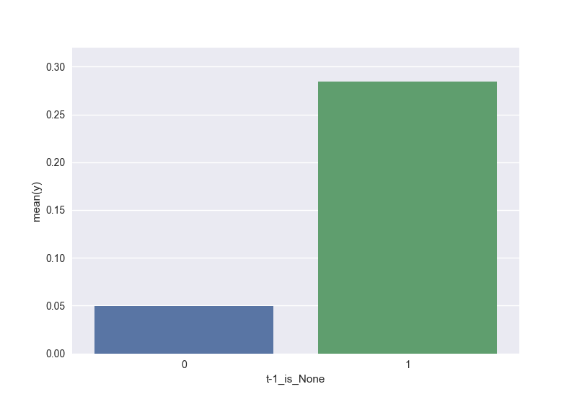
Important Findings for None - 3
t-1_is_None(User A) is a binary feature that says whether or not the user’s previous order was None.
If the previous order is None,
then the next order will also be
None with 30% probability.

Slide 30
F1 maximization
In this competition, the evaluation metric was an F1 score, which is a way of capturing both precision and recall in a single metric.
Thus, we needed to convert reorder probabilities into binary 1/0 (Yes/No) numbers.
However, in order to perform this conversion, we need to know a threshold. At first, I used grid search to find a universal threshold of 0.2. But I saw comments on the Kaggle discussion boards that said different orders should have different thresholds.
To understand why, let’s look at an example.

Slide 31
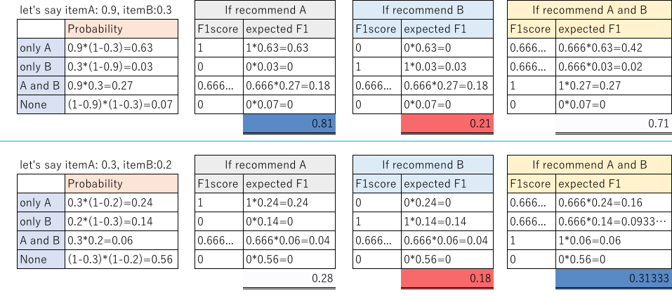
F1 maximization

Slide 32
F1 maximization
In the first example, threshold is between 0.9 and 0.3
In the second example, threshold is lower than 0.2
As I showed, each order should have each threshold
But using above calculation, we have to prepare all patterns of probability at first
Thus I needed to come up with another calculation
See the next page

Slide 33
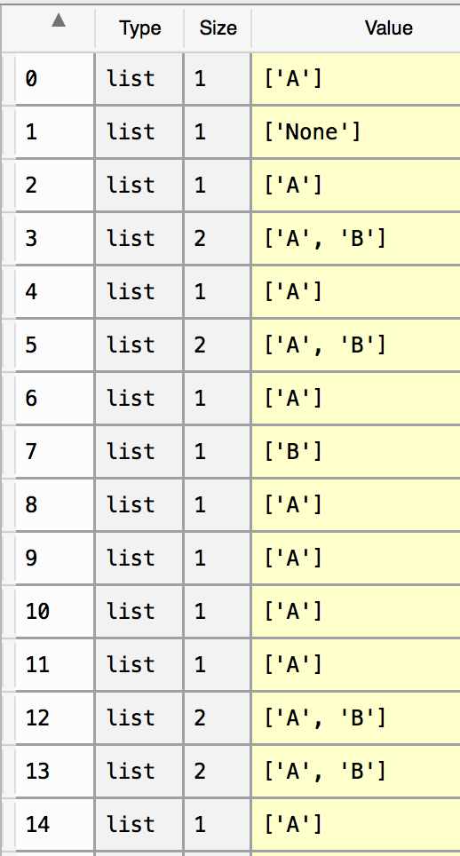
F1 maximization
Let’s say our model predicts Item A will be reordered with probability 0.9, and Item B with probability 0.3. I then simulate 9,999 target labels (whether A and B will be ordered or not) using these probabilities.
For example, the simulated labels might look like this.
I then calculate the expected F1 score for each set of labels,
starting from the highest probability items, and then adding items
(e.g., [A], then [A, B], then [A, B, C], etc) until the F1 score
peaks and then decreases.
We don’t need to calculate all of patterns
like A, B, AB…
Because if we should select itemB, we should
select itemA as well

Slide 34
F1 maximization
F1score_mean( , [A]) -> 0.809747641431
F1score_mean( , [A,B]) -> 0.709004233757

Slide 35
F1 maximization - Predicting None
One way to think about None is as the probability (1 - Item A) * (1 - Item B) * …
But another method is to try to predict None as a special case.
By using our None model and treating None as just another item, we can boost the F1 score from 0.400 to 0.407.

Slide 36
EOP

